Slide 1



OPA / ISSS Meeting
Tuesday
March 3, 2026

Slide 2

New Questions on Form I-129
What level of education is required for the position? *
What fields(s) of study would qualify someone for this position? *
How many years of experience are required in order to qualify for this position? *
What special skills are required in order to qualify for the position? *
How many people will the beneficiary supervise and what are their position titles? *

Slide 3
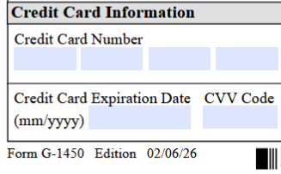
New Edition of Form G-1450
Please use the latest version of Form G-1450. It is available at www.uscis.gov/sites/default/files/document/forms/g-1450.pdf
The main change is that the form now requires the security code found on the back of the credit card.

Slide 4

Changes to Temple University’s J-1 Exchange Visitor Program
J-1 status is not appropriate if the scholar will:
Engage in any position that does not require the minimum of a Bachelor’s degree
Hold tenure-track or tenured faculty appointments
Enter the US to participate in a medical residency program or engage in clinical activities (Program Sponsor must be ECFMG)

Slide 5
Positions at Temple that may fall under the J-1 Exchange Visitor Program:
NTT Faculty
Adjunct Faculty
Postdoctoral Fellow
Research Position T24 or higher that is Exempt (not covered by a Collective Bargaining Agreement such as AFSCME)
  Once you have an HR offer, please give Gabby at least 2 months for international hires and 1 month for domestic transfers
Be aware that, unlike H-1B status, J-1 Exchange Visitor Status does not have Dual Intent. Filing for a Green Card while holding J-1 Status can be challenging as travel will be severely restricted.

Slide 6

Remaining Spring 2026 OPT Sessions
Tuesday, 3/10/2026 - https://temple.zoom.us/meeting/register/U_wMrhkxSveymOVvpDUQ6Q
Friday, 3/27/2026 - https://temple.zoom.us/meeting/register/ity70UrSS_qnvT0H-2Strw
There is still space available in both remaining sessions, but if you can't make it to either of them, feel free to reach out to Gabby or Joan with questions

Slide 7
OPA Appointment Letters and Forms
All Office of Postdoctoral Affairs (OPA) appointment letters and forms are available via TUportal. Log into TUportal and navigate to either “Staff Tools” or “Faculty Tools,” as applicable. Then, scroll to the bottom of the page to the University Forms channel located in the center column. To locate the OPA documents, enter “Postdoc” into the search field. This will bring up all relevant OPA forms, letters, and procedural documents.
******Ensure to retrieve appointment letters / forms for all submissions.

Slide 8
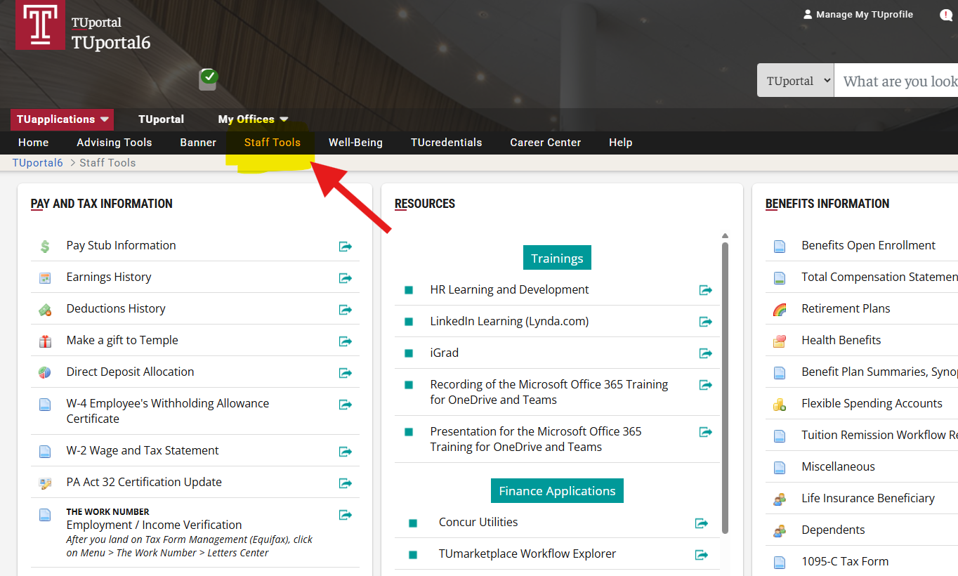
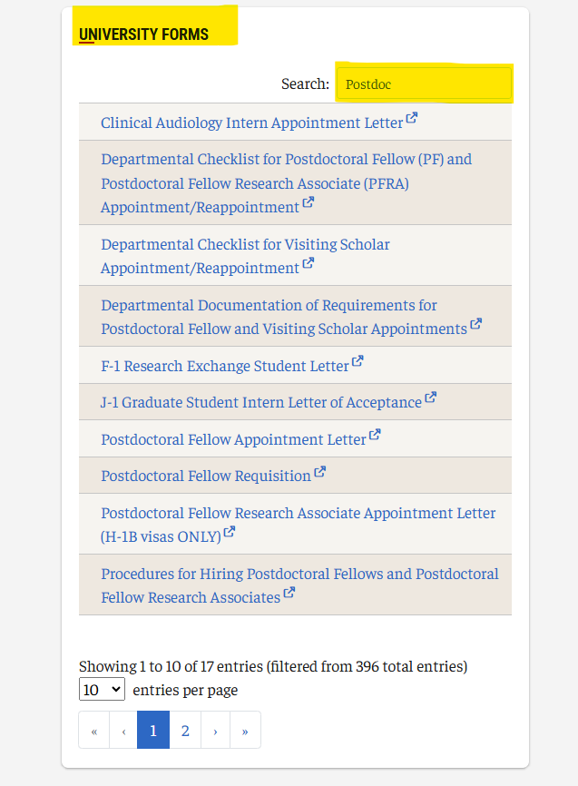
OPA Appointment Letters and Forms cont'd

Slide 9

List of Countries Removed From Skills List
The U.S. Department of State’s updated Exchange Visitor Skills List, effective December 9, 2024, has removed the following countries:
– Asia: Bahrain, Bangladesh, China, India, Indonesia, Kazakhstan, Laos, Malaysia, Oman, Saudi Arabia, South Korea, Sri Lanka, Thailand, United Arab Emirates
– Europe: Albania, Armenia, Georgia, Montenegro, Romania
– Americas: Argentina, Bolivia, Brazil, Chile, Colombia, Costa Rica, Dominican Republic, Guyana, Paraguay, Peru, Trinidad and Tobago, Uruguay
– Africa: Algeria, Eswatini (Swaziland), Gabon, Mauritius, Namibia, South Africa

Slide 10
Effective Date – Which Skills List Applies?
The 2024 Skills List applies to J exchange visitors who are admitted in J status, or who obtained J status, on or after December 9, 2024. If you were admitted to the United States in J status or obtain J status on or after December 9, 2024, and your country is on the 2024 Skills List, you are subject to the two-year home country physical presence requirement based on the Skills List.
If you were admitted to the United States in J status or obtained J status before December 9, 2024, and your country is not on the 2024 Skills List, you are not subject to the two-year home country physical presence requirement based on the Skills List; however, you may be subject to the requirement based on funding from the U.S. government or your home country government, or if you received graduate medical education or training in the United States.

Slide 11
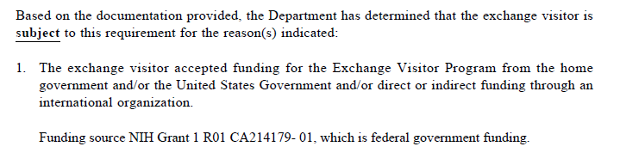

Slide 12

Question 1:
One small area I wanted to share with you now concerns the postdoc fellow requisition form, which requires completion and signature. My “wish list” includes updates to the text box areas on this form, which are way too small for entry, including the approval signature boxes. There’s hardly any room to include a signature on the sponsored projects side.

Slide 13
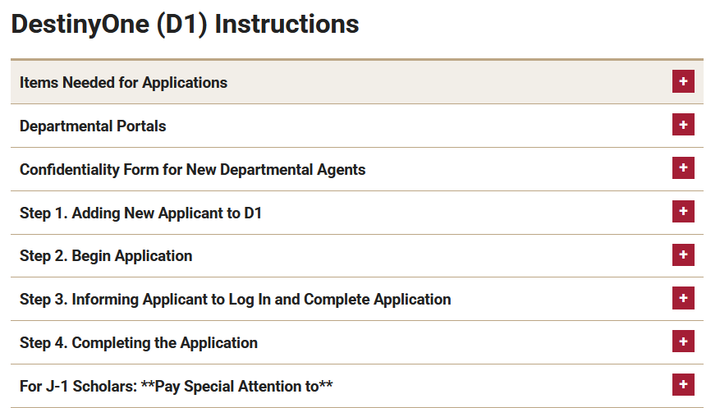
Question 2:
Will DestinyOne send the H-1B Applicant an email inviting him to complete his sections of the H-1B Application?
D1 does not send an email…the hiring department needs to send the email manually.
https://global.temple.edu/isss/hosting-departments/information-departments/destinyone-instructions

Slide 14
POSTDOCTORAL APPOINTMENT DURATION
Postdoctoral Fellow (PD) and Postdoctoral Fellow Research Associate (PDRA) appointments at Temple University are finite, with a maximum of 5 years allowed. This represents the longest time an individual may hold a PD or PDRA appointment at Temple.
At Temple University, the 5-year maximum for postdoctoral appointments is calculated based on the individual’s time at Temple, not their total postdoctoral experience elsewhere.
  For example, if a postdoc comes to Temple with 4 years of prior experience, the 5-year limit starts on their first day at Temple. This means they could be appointed for up to 5 additional years at Temple, regardless of prior postdoctoral experience at other institutions. Essentially, Temple counts only the time spent in postdoctoral appointments at Temple toward the maximum, allowing incoming postdocs with previous experience to transfer in without losing eligibility for the full 5 years.
    That said, it is generally unusual for a postdoc to have more than 7–8 years of total postdoctoral experience. By that point, individuals are typically expected to transition into a full-time research position, faculty role, or other academic career path.
      However, there are circumstances that can justify a longer postdoctoral period, such as switching research tracks or fields (which may require additional training and publications), participating in complex or long-term projects (such as longitudinal studies or multi-institution collaborations), or completing publications and strengthening the research record before applying for permanent positions, to name just a few.
Multi-year appointments are permissible, provided adequate funding is available and performance is reviewed annually.

Slide 15
PROFESSIONAL DEVELOPMENT
The Graduate School provides professional development services for master's students, doctoral students, and postdoctoral fellows.
Graduate Students and postdocs can meet with the Director of Student Engagement and Center Advancement (Mark Kaloko) through one-on-one appointments to discuss the following topics:
  Career exploration and planning
  CV/resume writing
  Interviewing
  Job searching and networking
Postdocs schedule appointments by emailing the Director of Student Engagement and Center Advancement (Mark Kaloko) at mark.kaloko@temple.edu.

Slide 16
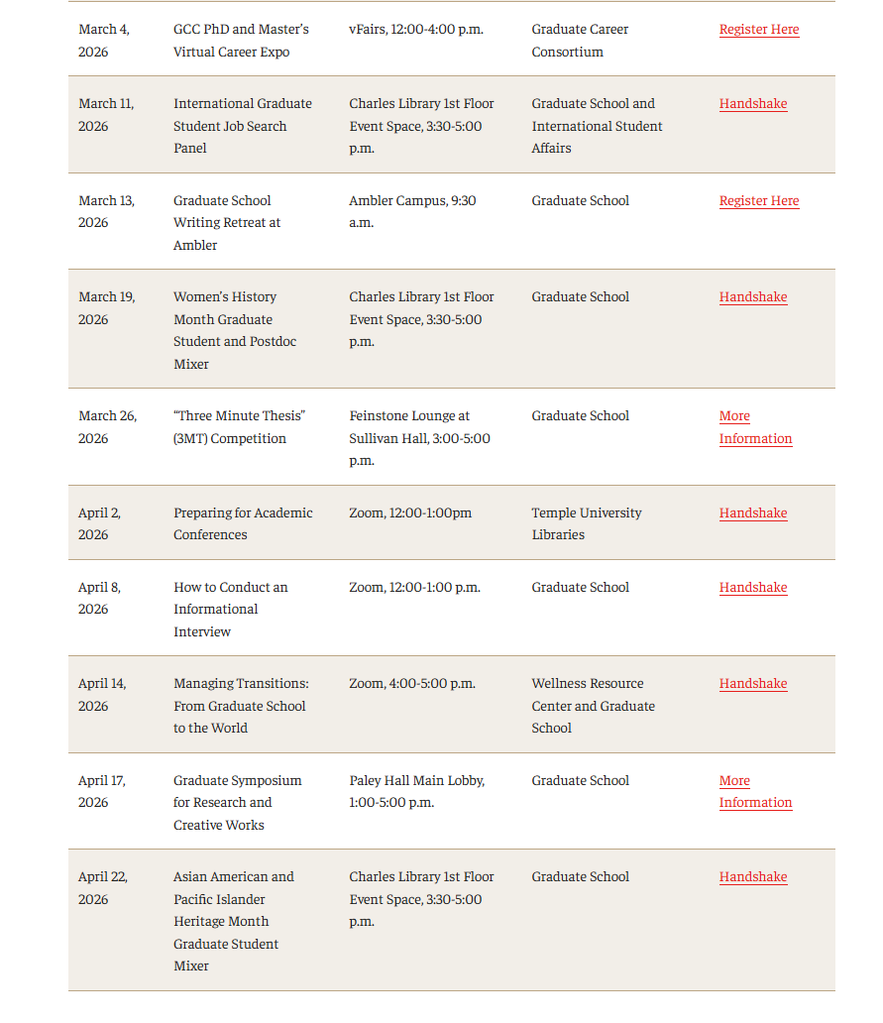
PROFESSIONAL DEVELOPMENT SCHEDULE
The Professional Development Schedule can be found directly at this link:
https://grad.temple.edu/resources/professional-development/initiatives

