Slide 1



April 21, 2026
Visa Options Beyond Practical Training
Emily M. Cohen🌐

Slide 2
Keep a Series of Temporary Visas until a Green Card Option is Possible
Big Picture
Permanent
Temporary
Some require “temporary intent”
Each has its own restrictions
Also called a “green card”
Can work anywhere
On a path to U.S. citizenship

Slide 3
What can I do, “on the side”?
Employment is any service or labor performed for wages or other remuneration
Employment authorization required for someone physically located in the U.S., regardless of where the employer is located
Unauthorized employment constitutes failure to maintain valid immigration status
Active Income v. Passive Income
  Be aware of social media presence that imply employment.

Slide 4

How do I talk to an employer about visas?
Larger employers have visa policies - ask to find out
Smaller ones may not have a policy and may need you to explain
If employer is nervous or confused, let us know
Notes:
4

Slide 5
Common Pathway, Not Required
F-1 Student Visa
Optional Practical Training (OPT)
H1-B Professional Worker Visa
Green Card
Notes:
5

Slide 6

H-1B Visa – Specialty Occupation
Bachelors or higher degree
Determine U.S. equivalence of foreign degree
Combination of education and experience
Job Offer (that will apply the academic/ specialty knowledge)
Part-time or full-time
Specialty Occupation
Job requires bachelor’s or higher degree in specific field
Requires Employer-Employee relationship (W-2 Wages)
H-1B Cap / Weighted Lottery
$100,000 Fee (Consular Processing)
H-1B Entrepreneurs / Business Owners
Must meet prevailing age/actual wage

Slide 7
H-1B1 Visas –
Citizens of Chile & Singapore
Similar Requirements to H-1B
  Bona-fide employer-employee relationship
  Must meet prevailing/actual wage 🡪 Labor Condition Application w/DOL
  Specialty occupation
Key Differences
  Can apply directly at U.S. Consulate abroad
  Visa valid in 18-month increments, admission for 1-year at a time
  100% nonimmigrant intent, but renewable indefinitely
  Yearly limit of visas never met

Slide 8

TN Visas –
Citizens of Canada and Mexico
Common Features
  Require nonimmigrant intent
  Authorize up-to-three years of stay
  Position/qualifications must appear on professions list – see 8 CFR 214.6
  No strict prevailing wage requirement
  Spouses / Children = TD
Differences Depending on Citizenship
  For Mexican Citizens – must apply for Visa at U.S. Consulate abroad, TN visa itself only valid for one-year increments
  For Canadian Citizens – may apply at the U.S. Border, Visa Exempt (but if spouse/children non-Canadian citizens, must apply for visa)

Slide 9

E-3 Visas –
For Citizens of Australia
Similar Requirements to H-1B (and H-1B1)
  Bona-fide employer-employee relationship
  Must meet prevailing/actual wage 🡪 Labor Condition Application w/DOL
  Specialty occupation
Key Differences
  Can apply directly at U.S. Consulate abroad
  Visa valid in 2-year increments
  100% nonimmigrant intent, but renewable indefinitely
  Spouses can apply for Employment Authorization
  Yearly limit of visas never met

Slide 10
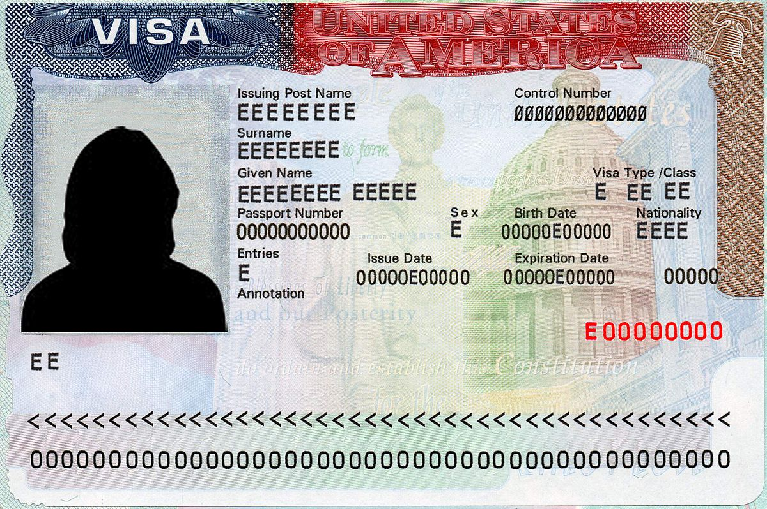
Other Temporary Work Visas
E, I, J, L, O, P, Q, R, U, etc.
Look at:
  the length of status it provides
  what work it requires/ allows for
  status of dependents
  ability to apply for green card
  quota
Let’s review the J, L, E and O since they are the most common...
Notes:
10

Slide 11

J-1 Has Various Categories
trainee (18 months)
specialist (1 year)
research scholar (5 years)
Common at universities but possible at “host companies” sponsored by third party nonprofit exchange program.

Slide 12

L-1: Intra-Company
Transfer Visa
L-1 A Executive / Manager
L-1 B Specialized Knowledge
Work for a year abroad, then transferred back to the U.S.
Spouse can work
Must have qualifying corporate relationship

Slide 13
E-1 / E-2 Treaty / Trader Visa
Nonimmigrant visa - renewable
Allows a treaty country national to be admitted to the US when investing “substantial” capital in a US business
  amount depends on business; $100,000 benchmark
Requires at least 50% ownership of US business (E-2 company)
No job creation requirement, but E-2 company must be real, operating, and generate income -> Business plan
Investor has control; no sponsorship required
Can work for treaty company employer if “essential employee”; avoid H-1B lottery

Slide 14

O-1 Visa: Individuals with Extraordinary Ability or Achievement
O-1A: Extraordinary Ability in the sciences, education, business, or athletics
O-1B: Extraordinary Ability in the arts or Extraordinary Achievement in motion picture or television industry
Peer consultation / advisory opinion required
Length of Stay- 3 year initial, with 1 year extensions; can extend indefinitely
O-3: Dependents of O-1s (spouses, unmarried children under 21)
  No work authorization

Slide 15
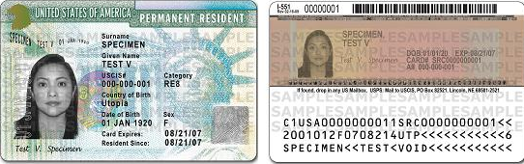
Once You Have a Green Card
You do not need to come to webinars like this…
But best to stay on temporary visas if you are not sure you want to stay the U.S.
Notes:
15

Slide 16

Green Card Through Permanent Labor Certification (PERM)
Requires a “test of the labor market” to show there are no qualified U.S. workers available for permanent full-time position at prevailing wage
DOL prevailing wage determination/Union?
  Advertising/Recruitment Effort
Employer must cover legal fees/costs for PERM which is first step in green card process
2-4 years, but longer for those born in China or India (unless processing with spouse born in another country)

Slide 17

Faster Tracks to a Green Card Through Employment
"Simplified” Labor Certification categories:
  University/College positions involving teaching (must file within 18 months of selection pursuant to competitive selection and recruitment process)
  Must document that applicant is the “best” for the position
  Registered Nurse/Physical Therapist/ Sheep Herder
No advertising/No PERM:
  Outstanding Researcher/Professor EB-1B
  Self Petition Extraordinary Ability EB-1A
  Self Petition National Interest Waiver EB-2
Notes:
17

Slide 18

Filing for Permanent Residence (Immigrant Visa /Green Card)
Immigrant Visa Must be Available (Visa Bulletin)
Long Wait Time for Applicants born in India and China
Adjustment of Status filed with USCIS (Form I-485)
  Can obtain employment authorization (EAD) while I-485 is pending
Concurrent Filing of I-140/I-485
Portability with Approved I-140 and I-485 unadjudicated after 180 days

Slide 19

Other Permanent Visas
Family-Based
  Marriage to a U.S. citizen or permanent resident most common
Asylum
  Fear of persecution in your home country
Notes:
19

Slide 20


For Further Information
Any Questions?
  EMILY M. COHEN ESQ.
  ECOHEN@GANDS-US.COM
  (267) 930-6411
  1524 Delancey Street, 4th Fl
  Philadelphia, PA 19102 U.S.
WWW.GANDS-US.COM
(215) 395-8959
Facebook: @GreenAndSpiegelLLP
Instagram: @GreenAndSpiegel
  LinkedIn: @green-&-spiegel
  X: @GreenAndSpiegel

